Slide 1
Temporal Graph Neural Networks for forecasting Diseases
Afraz Arif Khan [PHSA]

Slide 2
Land Acknowledgment
I respectfully acknowledge that I live and work on the traditional, unceded homelands of the xʷməθkʷəy̓əm (Musqueam), Sḵwx̱wú7mesh (Squamish), and Səl̓ílwətaʔ/Selilwitulh (Tsleil-Waututh) Nations, as well as the hən̓q̓əmin̓əm̓-speaking peoples. I commit to meaningful reconciliation and to supporting Indigenous sovereignty, culture, and resilience in all that I do.

Slide 3
Table of contents
Introduction
‘Traditional’ Machine Learning
Graphs
Graph Neural Networks
Temporal Graph Neural Networks
Chicken Pox: A temporal GNN case study
Conclusion
Resources
References

Slide 4
Introduction
Today’s DSR presentation will focus on a subset of Graph Neural Networks (GNNs), namely Temporal GNNs due to their widespread utility in disease forecasting
We will cover:
The need for GNNs over classic ML design
Intro to graphs and Temporal GNNs
Hungary Chicken Pox data: A live tGNN case study

Slide 5
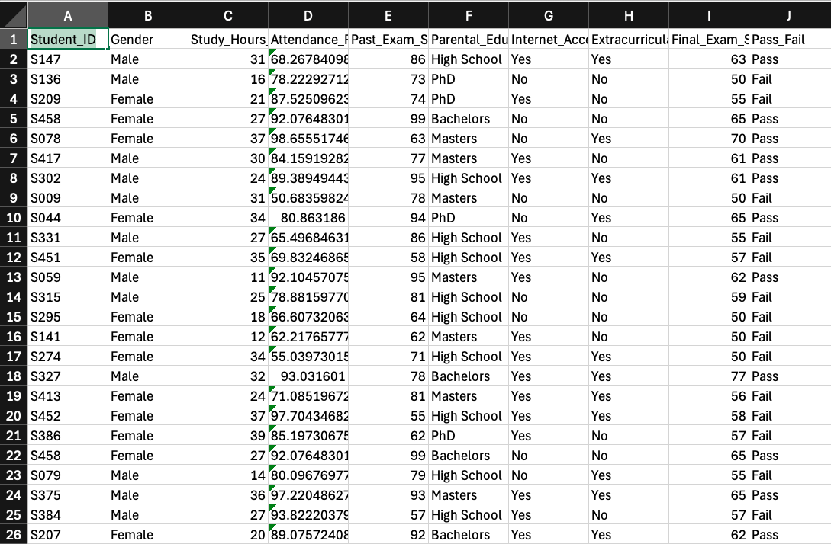
‘Traditional’ Machine Learning
Usually you have a tabular dataset. Predict students who pass/fail

Slide 6

‘Traditional’ Machine Learning
Usually you have a tabular dataset. Predict students who pass/fail
All supervised ML problems with tabular input fall into the:
$$f\left(X\right)→y$$
Learn some function f on features X to predict y
My features: X
My prediction: y

Slide 7
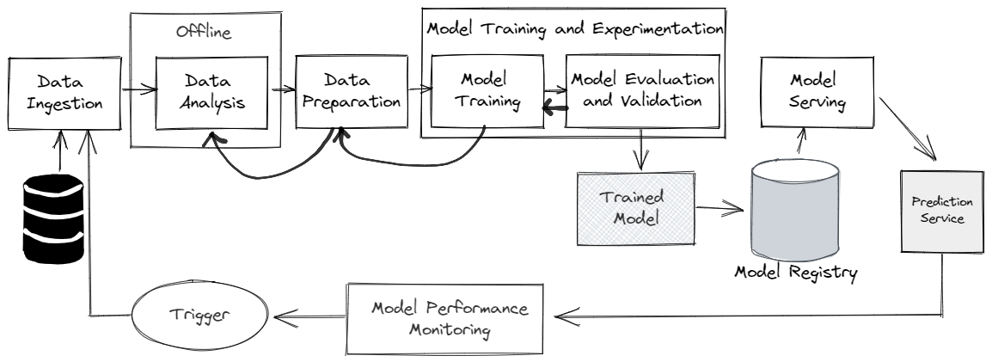
General ML pipeline workflow

Slide 8
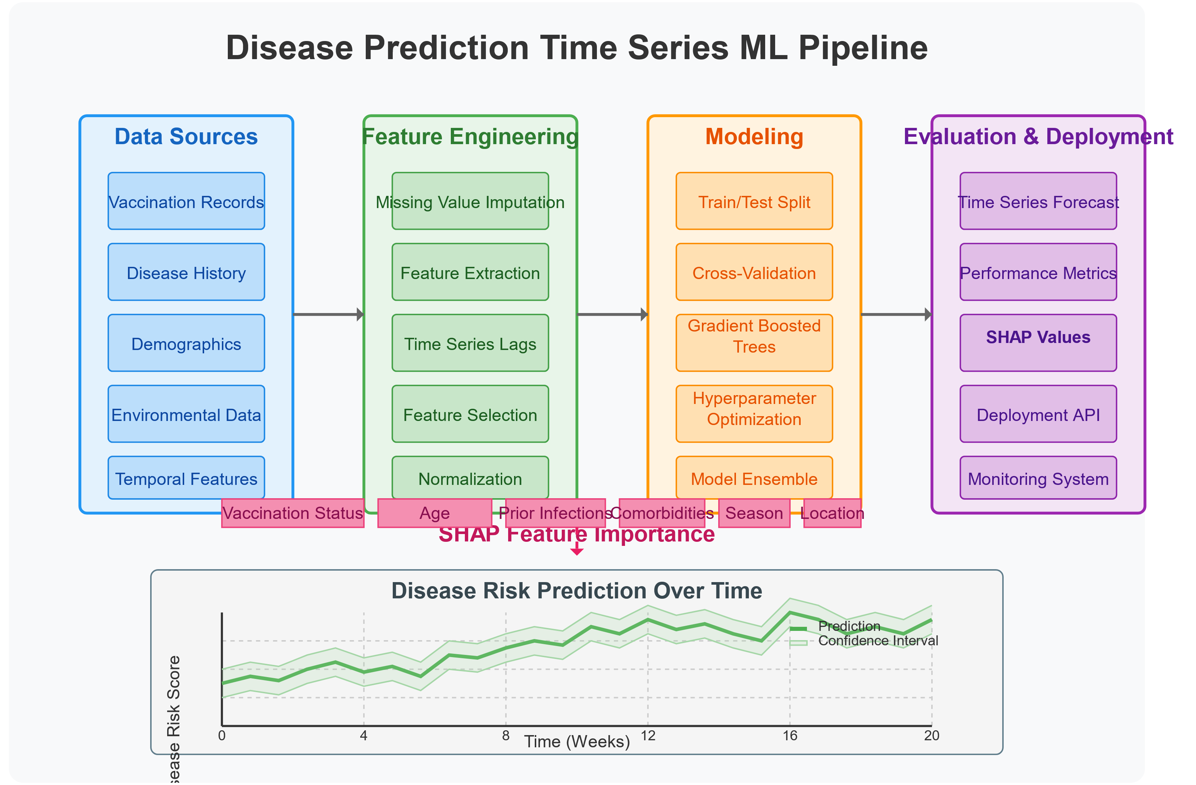
General ML Pipeline Workflow
Perform ETL
Decide features with domain experts
Deploy a battery of models for good spread
Evaluate and train your models repetitively
Show time-series value, make sure predictions fall in a good range and are better than baseline approaches

Slide 9
Caveats of the traditional approach?
TGNNs can model spatial and temporal dependencies inherently, this effect needs to be feature engineered for the traditional approach
TGNNs can use dynamic graphs, traditional models struggle to capture changing network dynamics
TGNNs excel at capturing non-linear relationships, traditional models struggle (w.r.t TGNNs) if there is a complex dataset with many interdependent variables

Slide 10
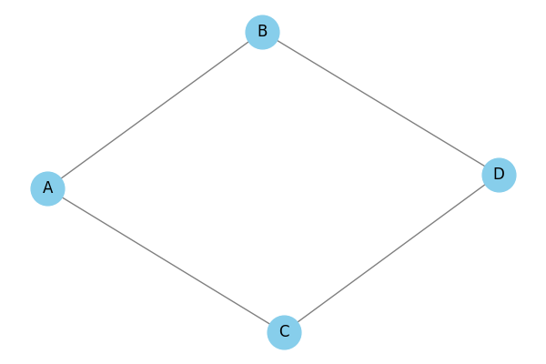
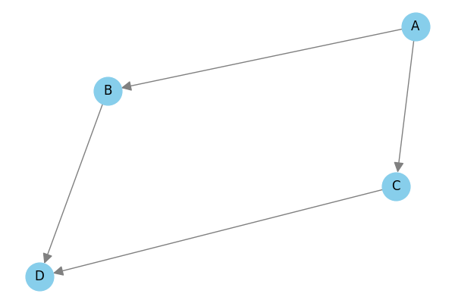
What are Graphs?
Directed Graphs
Undirected Graphs
Simple graph on 4 nodes. We will only work with undirected graphs

Slide 11
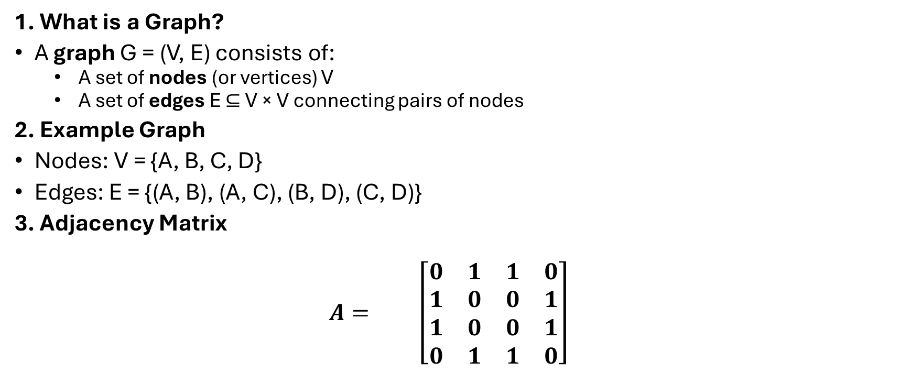
What are Graphs?
1. What is a Graph?
A graph G = (V, E) consists of:
A set of nodes (or vertices) V
A set of edges E ⊆ V × V connecting pairs of nodes
2. Example Graph
Nodes: V = {A, B, C, D}
Edges: E = {(A, B), (A, C), (B, D), (C, D)}
3. Adjacency Matrix
$$A= \left[\begin{matrix}0 & 1 & 1 & 0 \\ 1 & 0 & 0 & 1 \\ 1 & 0 & 0 & 1 \\ 0 & 1 & 1 & 0\end{matrix}\right]$$
A B C D
A B C D

Slide 12
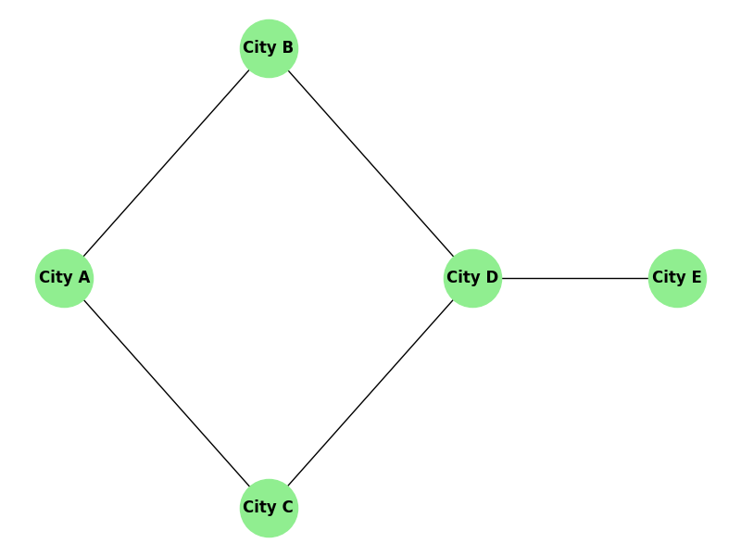
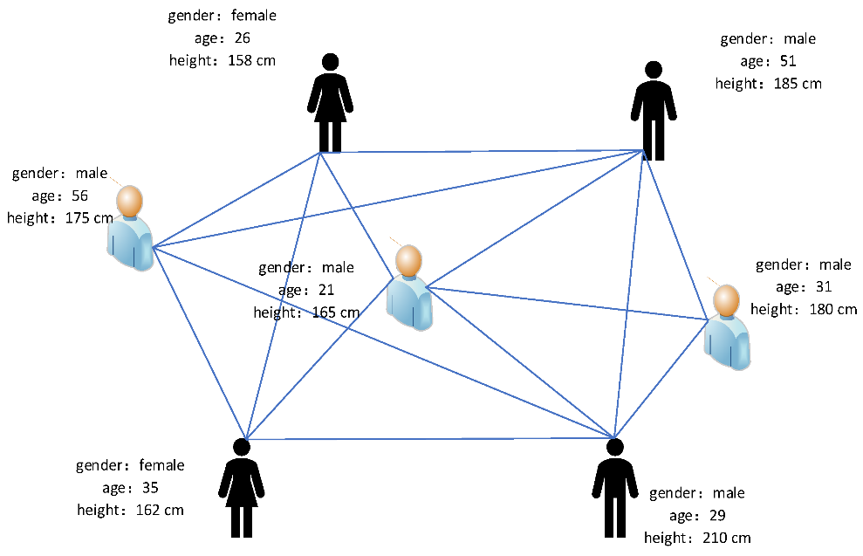
Popular examples of Graph Networks
Social Network
Geography

Slide 13
Quick Recap on Neural Networks
Basic Neural Network
2 hidden layers
Backpropagates the loss to optimise weights

Slide 14
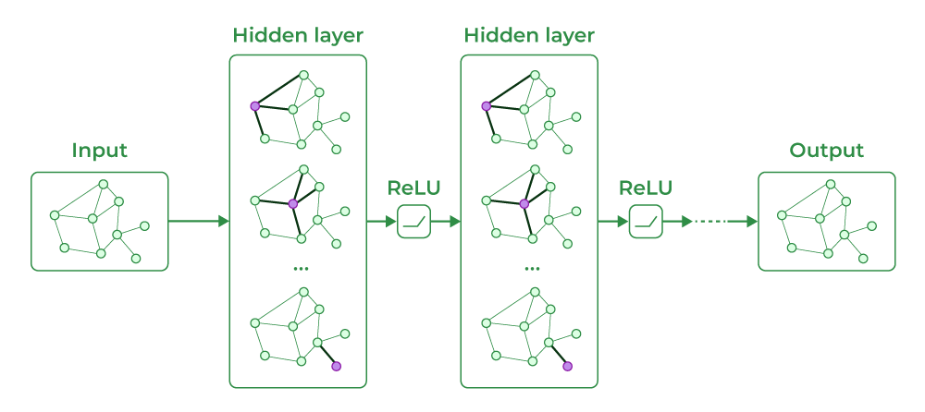
Graph Neural Networks
The input layer has X features per node, N nodes and E edges
Each dimension of the hidden layer is itself the graph and corresponding nodes pass messages and update each other in a convolved fashion
This output is sent through a non-linear activation function
Then the prediction y is across N nodes
Network focuses on important patterns
Network focuses on important patterns
Only knows about itself
Graph has predictions
Looks at immediate neighbors
Looks at neighbor of neighbors

Slide 15

Graph Neural Networks
Suppose you have an input feature matrix: $X∈ℝ^{N×K}$and you can think of each row $x_{i}$as a feature for Node $i$: $\left(\begin{matrix}x_{1} & ⋯ & x_{K}\end{matrix}\right)$ where $K$ is the number of features, you have $y∈ℝ^{N}$ predictions (assuming you are predicting 1 thing)
Input Layer
Hidden Layer
Output Layer
Only knows about itself, has features and edges
Looks at immediate neighbors in first hidden layer, then neighbor of neighbors in second hidden layer
Each node has an output prediction (like number of hospital visits)

Slide 16
Graph Neural Networks in Action
Looking at the output of Node 5
Each node is influenced by its own features and the features of its immediate neighbors
This is only an animation with 2 hidden layers showing the output of Node 5
This then backpropagates, optimises over MSE (for example)
Notes:
MSE and MAE are good for regression tasks, MSE for big errors, MAE for outliers
Binary Cross Entropy (BCE) for Binary Classification
Categorical problems use Categorical Cross-Entropy

Slide 17
Temporal Graph Neural Networks

Slide 18
Popular libraries to install GNN
PyTorch
GDL

Slide 19

Installation woes
Installation is far from perfect
There are a lot of library conflicts, NVIDIA driver issues and above all some compiler code warnings
There is a comprehensive README guide available at the end of this presentation for those interested in reproducing this work

Slide 20
Using Chicken Pox

Slide 21
A quick demo on Chicken Pox in Hungary

Slide 22
Popular applications of GNNs in disease forecasting
Instead of using Static Graphs you can use dynamic graphs
Each person represents a node and they can represent Infected persons entering the network
This builds new edges and new connections (exposes) and over time these nodes may leave (recover)

Slide 23
Dynamic tGNNs: Pandemics

Slide 24
Conclusion

Slide 25
Resources
Full repo: https://github.com/Afraz496/dsr_gnn_pres
Setup guide for Torch + GNN: https://github.com/Afraz496/dsr_gnn_pres/blob/main/tensorflow_setup.md

Slide 26
References
[1] Spatio-temporal Graph Neural Networks are extensions of Graph Neural Networks that take the time factor into account
[2] Graph Neural Networks (GNNs) have become the leading paradigm for learning on (static) graph-structured data. However, many real-world systems are dynamic in nature, since the graph and node/edge attributes change over time
[3] GNNs are designed to process graph data, making them a powerful tool for tasks where relationships between data points matter.
[4] Graph Neural Networks (GNNs) are a type of deep learning model that can be used to learn from graph data. GNNs use a message-passing mechanism...

Slide 27
Convolutional Neural Networks
Same as previous slide
CNNs differ from regular NNs by applying a filtering window which help selects subsections

